Slide 1
Binary Search Tree

Slide 2
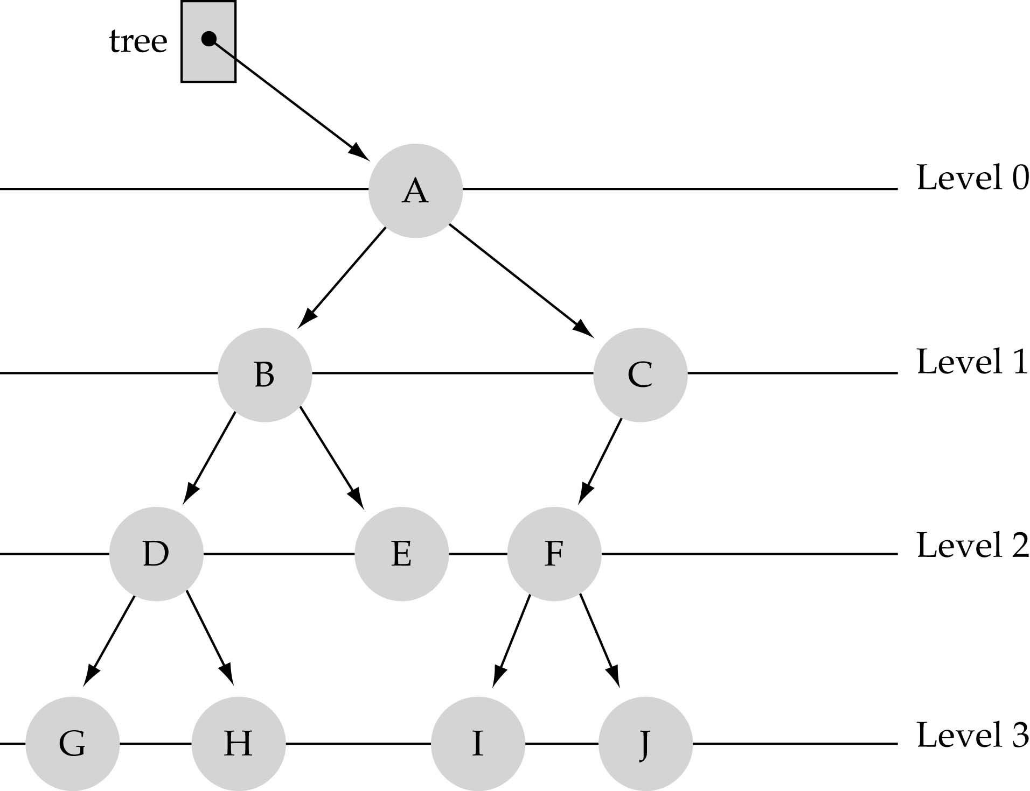
What is a binary tree?
Property 1: each node can have up to two successor nodes.

Slide 3
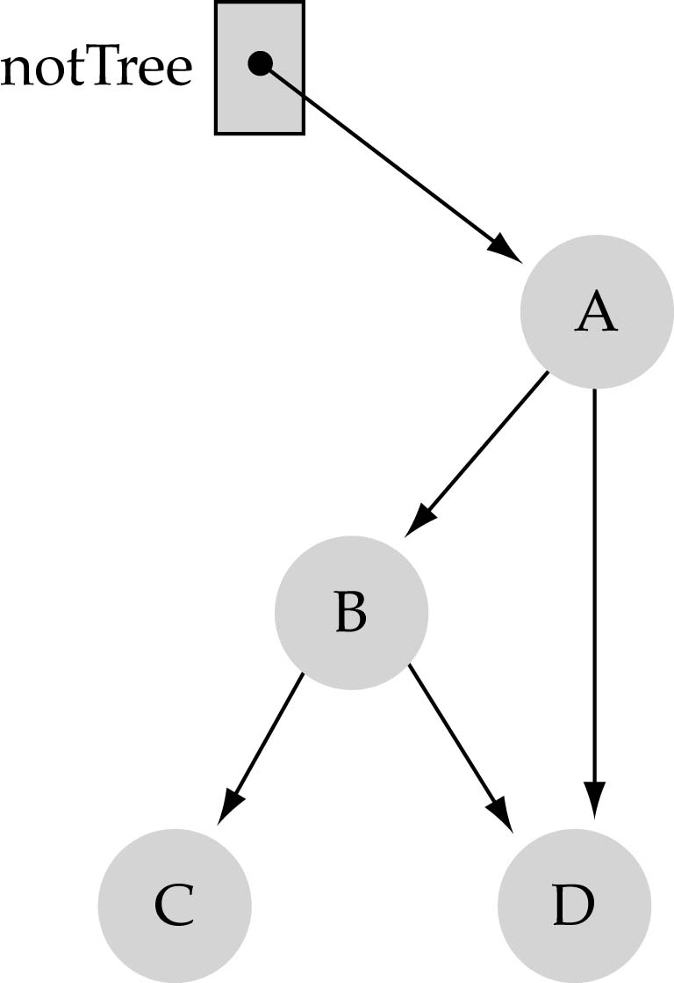
What is a binary tree? (cont.)
Property 2: a unique path exists from the root to every other node
Not a valid binary tree!

Slide 4
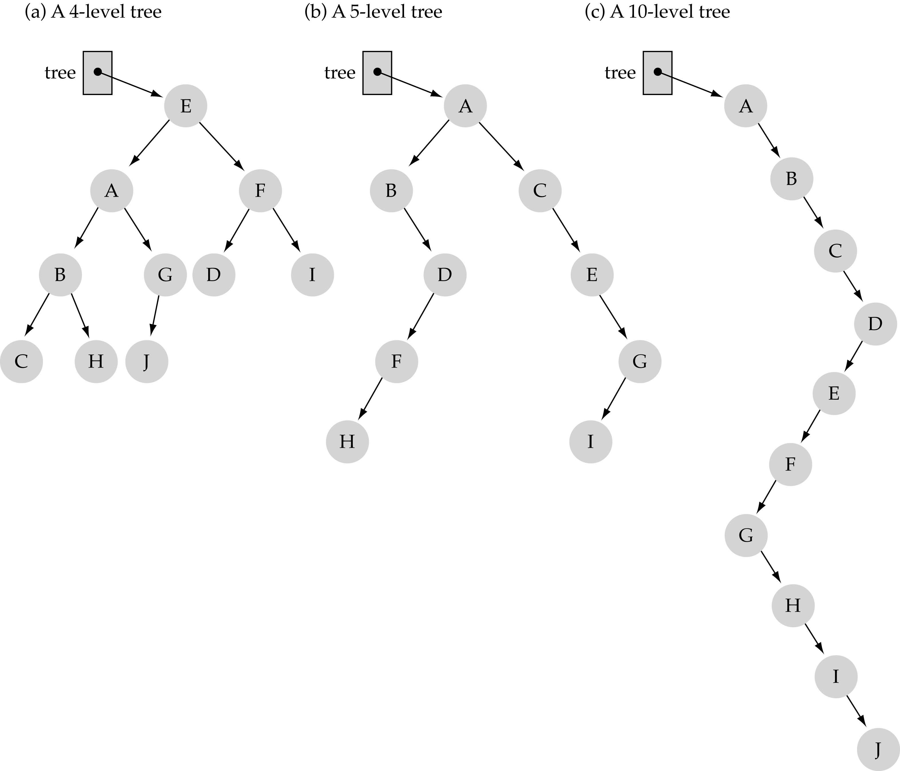
Some terminology
The successor nodes of a node are called its children
The predecessor node of a node is called its parent
The "beginning" node is called the root (has no parent)
A node without children is called a leaf

Slide 5
Some terminology (cont’d)
Nodes are organize in levels (indexed from 0).
Level (or depth) of a node: number of edges in the path from the root to that node.
Height of a tree h: #levels = L
(Warning: some books define h
as #levels-1).
Full tree: every node has exactly
two children and all the
leaves are on the same level.
not full!

Slide 6
What is the max #nodes at some level l?
The max #nodes at level is
where l=0,1,2, ...,L-1

Slide 7
What is the total #nodes N of a full tree with height h?
l=0
l=1
l=h-1
using the geometric series:

Slide 8
What is the height h of a full tree with N nodes?

Slide 9
Why is h important?
Tree operations (e.g., insert, delete, retrieve etc.) are typically expressed in terms of h.
So, h determines running time!

Slide 10
What is the max height of a tree with N nodes?
N (same as a linked list)
What is the min height of a tree with N nodes?
log(N+1)

Slide 11
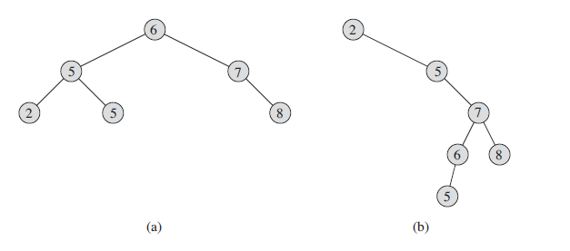
Binary Search Tree
A binary search tree is organized, as the name suggests, in a binary tree, as shown in Figure

Slide 12

Binary-search-tree property

Slide 13
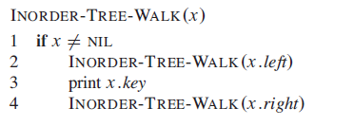
Traversing a Binary Search Tree
In-order
Pre-order
Post-order

Slide 14
Dynamic-set of Operations on BST
The search tree data structure supports many dynamic-set operations, including
SEARCH,
MINIMUM,
MAXIMUM,
PREDECESSOR,
SUCCESSOR,
INSERT, and
DELETE.

Slide 15
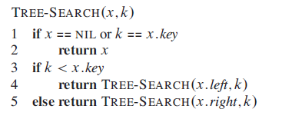
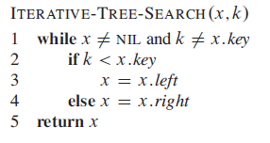
SEARCH
Recursive Version
Iterative Version

Slide 16
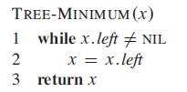
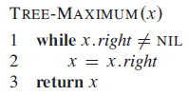
Minimum and Maximum

Slide 17
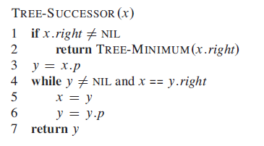
Successors and Predecessors

Slide 18
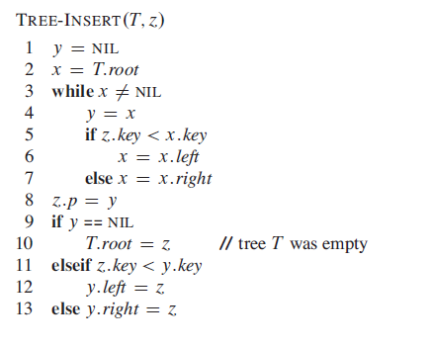
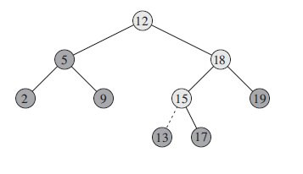
Insertion and Deletion

Slide 19
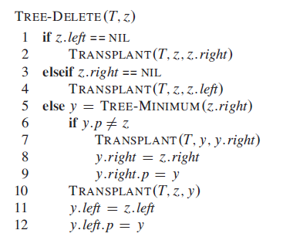
Deletion

